Slide 1
Adjustable Cluster Heatmap Visualization Tool for Differential Expression and Pathway Analysis
Jim Rasband
(Data824 Spring 2025)

Slide 2
Introduction & Literature Review
This project grew out of the notion that there are a finite number of behavioral endophenotypes in autism (Constantino, 2018) in concert with similar findings related to neural circuits across numerous neurodevelopmental disability categories (Tozzi et al., 2024).
Simultaneously, there are typically also a finite number of standard courses of treatment in the pharmacogenomic space as regards their use across neurodevelopmental disabilities as well as within a particular disability. Regardless, a common theme across neurodevelopmental disability categories (perhaps particularly autism) is a very long period of trying various medications before finding the ”right fit.” That is, a medication which manages symptoms and causes minimal side effects.

Slide 3
Introduction & Literature Review
With the thorny nature of neurodevelopmental disabilities research, there is a great need to reduce data dimensionality. How that reduction is approached, however, varies considerably across studies. Most frequently, some combination of these approaches are utilized. However, there is not presently a strong standard for how best to approach inquiry, and as such, datasets include some combination but rarely all of the data that would be necessary for accurate comparisons across studies’ datasets.
Two such approaches include…

Slide 4
Literature Review – Constantino (2018)
Discusses possible features predictive of autism, especially thinking towards a neurodegenerative/aggregative model predicated on genes’ interactions and co-aggregation with environmental and behavioral factors (as well as other factors)
Notes overwhelming evidence for the influence of additive genetic risk in the majority of the population-attributable-risk for autism (As cited in Constantino, 2018: Constantino et al., 2013; Sandin et al., 2017)
Also notes evidence for aggregation of recessive or additive risk in sporadic occurences of autism (Wellner et al., 2017, as cited in Constantino, 2018)
Constantino, J. N. (2018). Deconstructing autism: From unitary syndrome to contributory developmental endophenotypes. International Review of Psychiatry, 30(1), 18–24. https://doi.org/10.1080/09540261.2018.1433133

Slide 5
Literature Review – Constantino (2018) (continued)
Family members (nuclear and extended) share a unitary symptom structure and align well genetically given an aggregate framework
Provides 4-component means for measurement of endophenotype in autism (irrespective of gene impacted): social visual disengagement, autism-specific background, motor coordination (non-ASD specific), & ADHD Trait Impulsivity
Possible ways to cluster data: may see some profiles emerge from these when taken together with or as a theoretical filter for other datasets.
Motor impairments and attention/hyperactivity in ASD are prevalent, and treatment related to motor skills often ameliorates many autism symptoms.
Aligns well with Tozzi et al. (2024) in implication regarding motor circuit involvement.
Offers a possible way to align behavioral, genetic, and neuroimaging data
Constantino, J. N. (2018). Deconstructing autism: From unitary syndrome to contributory developmental endophenotypes. International Review of Psychiatry, 30(1), 18–24. https://doi.org/10.1080/09540261.2018.1433133

Slide 6
Tozzi et al. (2024)
Tozzi et al. (2024) used fMRI to map neural circuits to distinguish biotypes across a variety of neurodevelopmental disabilities
Participants’ diagnoses included:
major depressive disorder, generalized anxiety disorder, panic disorder, social anxiety disorder, obsessive–compulsive disorder, & post-traumatic stress disorder.
Analyses revealed 6 distinct groups regardless of diagnostic label
Largely centered around differences motor-implicated neural circuits
Diagnostic value outperformed both molecular genetics data and behavioral data → researchers suggest task-free fMRI should be used in work up related to psychiatric and behavioral interventions.
Tozzi, L., Zhang, X., Pines, A., Olmsted, A. M., Zhai, E. S., Anene, E. T., Chesnut, M., Holt-Gosselin, B., Chang, S., Stetz, P. C., Ramirez, C. A., Hack, L. M., Korgaonkar, M. S., Wintermark, M., Gotlib, I. H., Ma, J., & Williams, L. M. (2024). Personalized brain circuit scores identify clinically distinct biotypes in depression and anxiety. Nature Medicine, 30(7), 2076–2087. https://doi.org/10.1038/s41591-024-03057-9

Slide 7
Introduction & Literature Review
Molecular genetic differences may likely help to reduce data dimensionality in selecting psychiatric medications and even allow for moving towards less invasive methods (e.g., dietary and behavioral interventions). However, the present literature base and sequencing abilities render use of genetics datasets difficult to replicate or interpret in a broader context. Simultaneously, methods such as neuroimaging may rapidly reduce data dimensionality, but they are insufficient to make judgments about medication selections. The same could also be said for examining behavioral data.
In short, there exists a large problem: we have all this data, but it’s quite difficult to compare in a straightforward and rapid way.

Slide 8
Introduction & Literature Review
This project considers the notion that visualization using set numbers of clusters might be a useful means of determining the general level on inquiry for next steps in research. For example, were one to examine a molecular genetics dataset (similar to Constantino) in knowledge of the dataset from Tozzi and colleagues, one might reasonably wish to further cluster in terms of 6 overall groups (as Tozzi and colleagues reported). By so doing, the list of genes which are significantly enriched or pathways implicated might meaningfully change. By refining that understanding, one might then further cluster among those groups at a molecular level.

Slide 9
Project Goals
Create a tool to visualize gene enrichment & pathway analysis data
Allow flexibility related to number of genes and pathways to examine
Allow flexibility related to number of clusters to use in visualization
Help to rapidly reduce data dimensionality to find relevant features for examination.

Slide 10
Why gene enrichment and pathway analysis?
Gene enrichment helps reveal molecular roles of single gene-level differences
Allows for more targeted future inquiry in research
EX: directions for future research: finding candidate genes for more targeted inquiry
Pathway analysis allows for thinking about system interactions
Easy to think about systems architecture
EX: If two phenotypes are highly aligned in terms of pathways expressed, but vary only in 1-2 metrics, it’s easier to think about interactions between systems and downstream consequences of molecular gene function.
Allows further fine-tuning as regards next areas of inquiry
EX: if highly expressed genes collectively are associated with how the body handles vitamin B12, one might shift thinking towards examining methylation data

Slide 11
Why flexible number of genes and pathways?
RNA_seq data is typically best examined in terms of adjusted p-value and log2 fold change
Depending on the process being examined, the threshold values for each vary greatly.
By allowing for adjustment within the tool, researchers can choose appropriate values given their particular research question and anticipated effect sizes.

Slide 12

Why flexibility related to cluster size?
Visualizing clusters of different sizes may help reveal the pathways which are important to particular endophenotypes.
1
EX: Tozzi et al. (2024) found 6 endophenotype neural circuits across both anxiety and depression (i.e., it didn’t matter which diagnostic label, there were a finite set of options). → 6 clusters theoretically aligns.
EX: grouping on a set of behavioral features or syndromes present in a dataset (e.g., autism related to fragile X syndrome vs Angelmann syndrome vs idiopathic → set at 3 clusters
Allowing for easy adjustment might provide an expedited means of judging whether a further examination is appropriate.
2
EX: Does using 6 groups produce well clustered genes and pathways? Next steps may involve filtering for genes which express in brain tissue.

Slide 13
Example Use Case
EXAMPLE USE CASE: If a particular group demonstrated important differences related to how the body handles vitamin B12, one might then consider the biological processes B12 is implicated in and thereby reveal interesting follow-up studies
EX: B12 is a precursor to s-adenylmethionine, so perhaps methylome sequencing would be valuable
EX: B12 deficiency is associated with fatigue, thus following serum B12 levels and patient report of fatigue in pharmacological intervention using a medication known to impact B12 levels could provide contribute valuably to outcomes tracking and determining goodness of fit of that particular medication).

Slide 14
App Design
Looks at Differential Expression data
Does not work for other types of analyses presently
Files MUST be formatted for excel (.xlsx)
Data can be input from any user, but must be in the following format:
Column 1 should be labeled ”GeneName”
Do not factor convert or otherwise reformat—app treats as numeric
Columns 2+ are participant identifiers
Use the participant identifier of your choosing
Any character vector is fine—do not reformat/redefine.
Rows MUST be Gene Ensemble ID (e.g., ENSG00000128573)
Note that it only works for hsapiens genes (not mice, drosophilia, etc.).

Slide 15
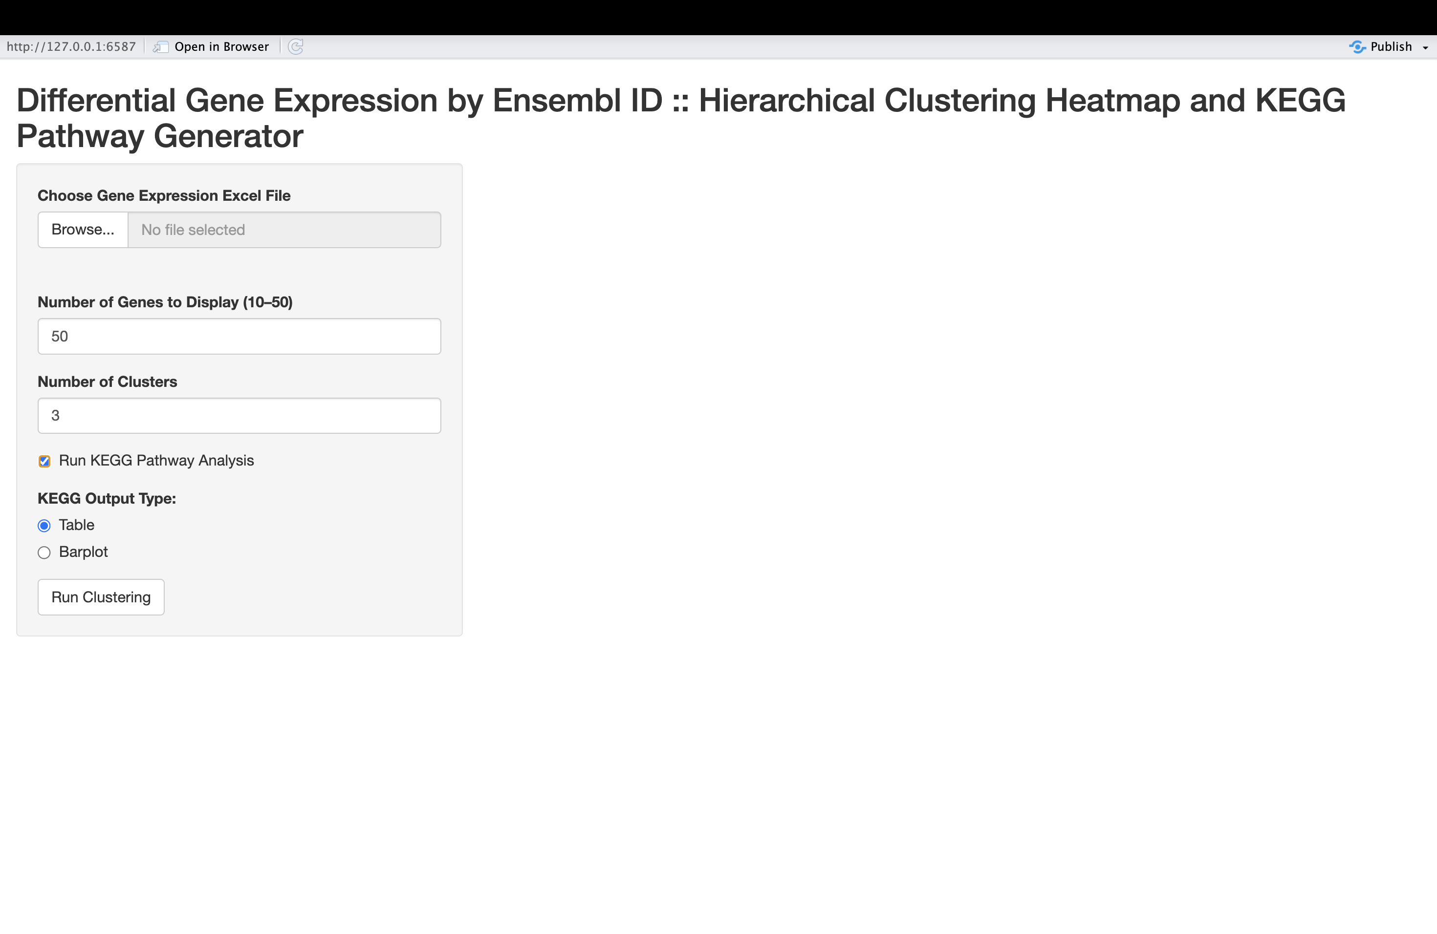
App home page

Slide 16
App Output
The app will produce three visualizations
1) Clustered Heatmap of genes’ differential expression across participants
Users can select the number of genes to display and clusters to group by
2) Table of all pathways expressed and the number of times expressed
Does not cull to top 10--gives pathway for whatever initial number of genes, which is set by the user.
A bit ugly, but easy to copy/paste into excel if you want new columns, at least.
3) Barplot of top 10 most expressed pathways
Provides count for number of genes from the dataset were in the pathway (y-axis) and KEGG pathway ID (x-axis).

Slide 17
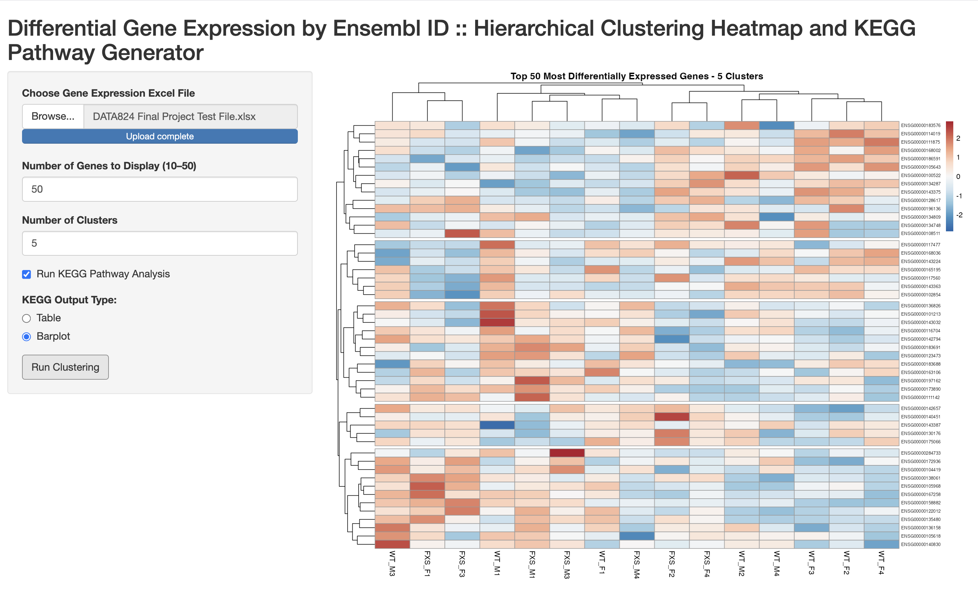
Clustered heatmap output clustered by gene name and differential expression marked by dataset identifier

Slide 18
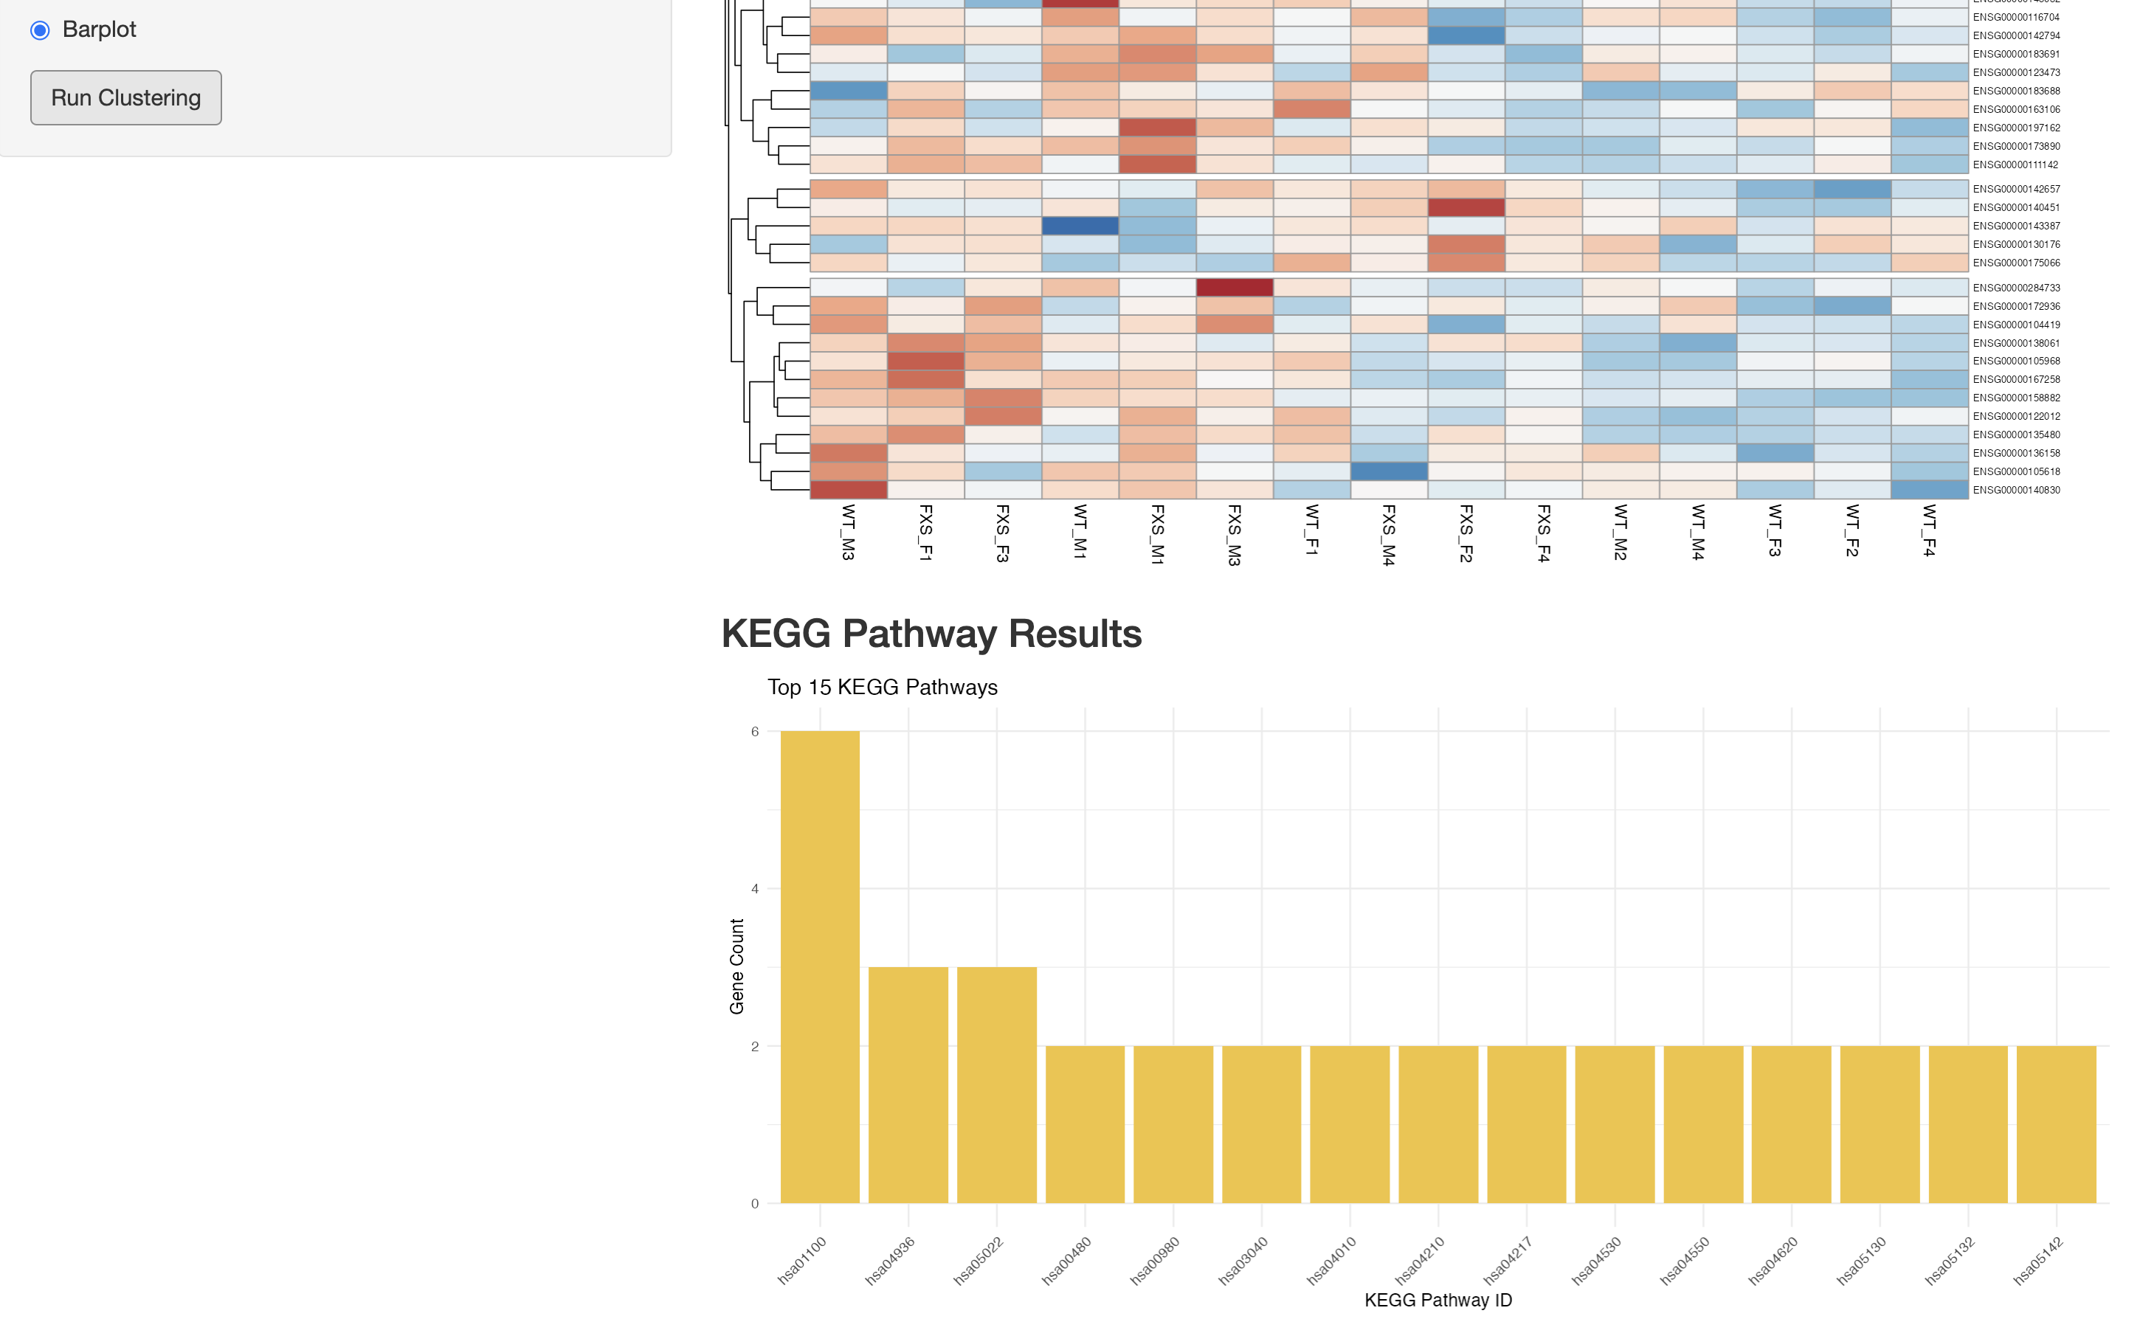
KEGG Pathway output – Barplot

Slide 19
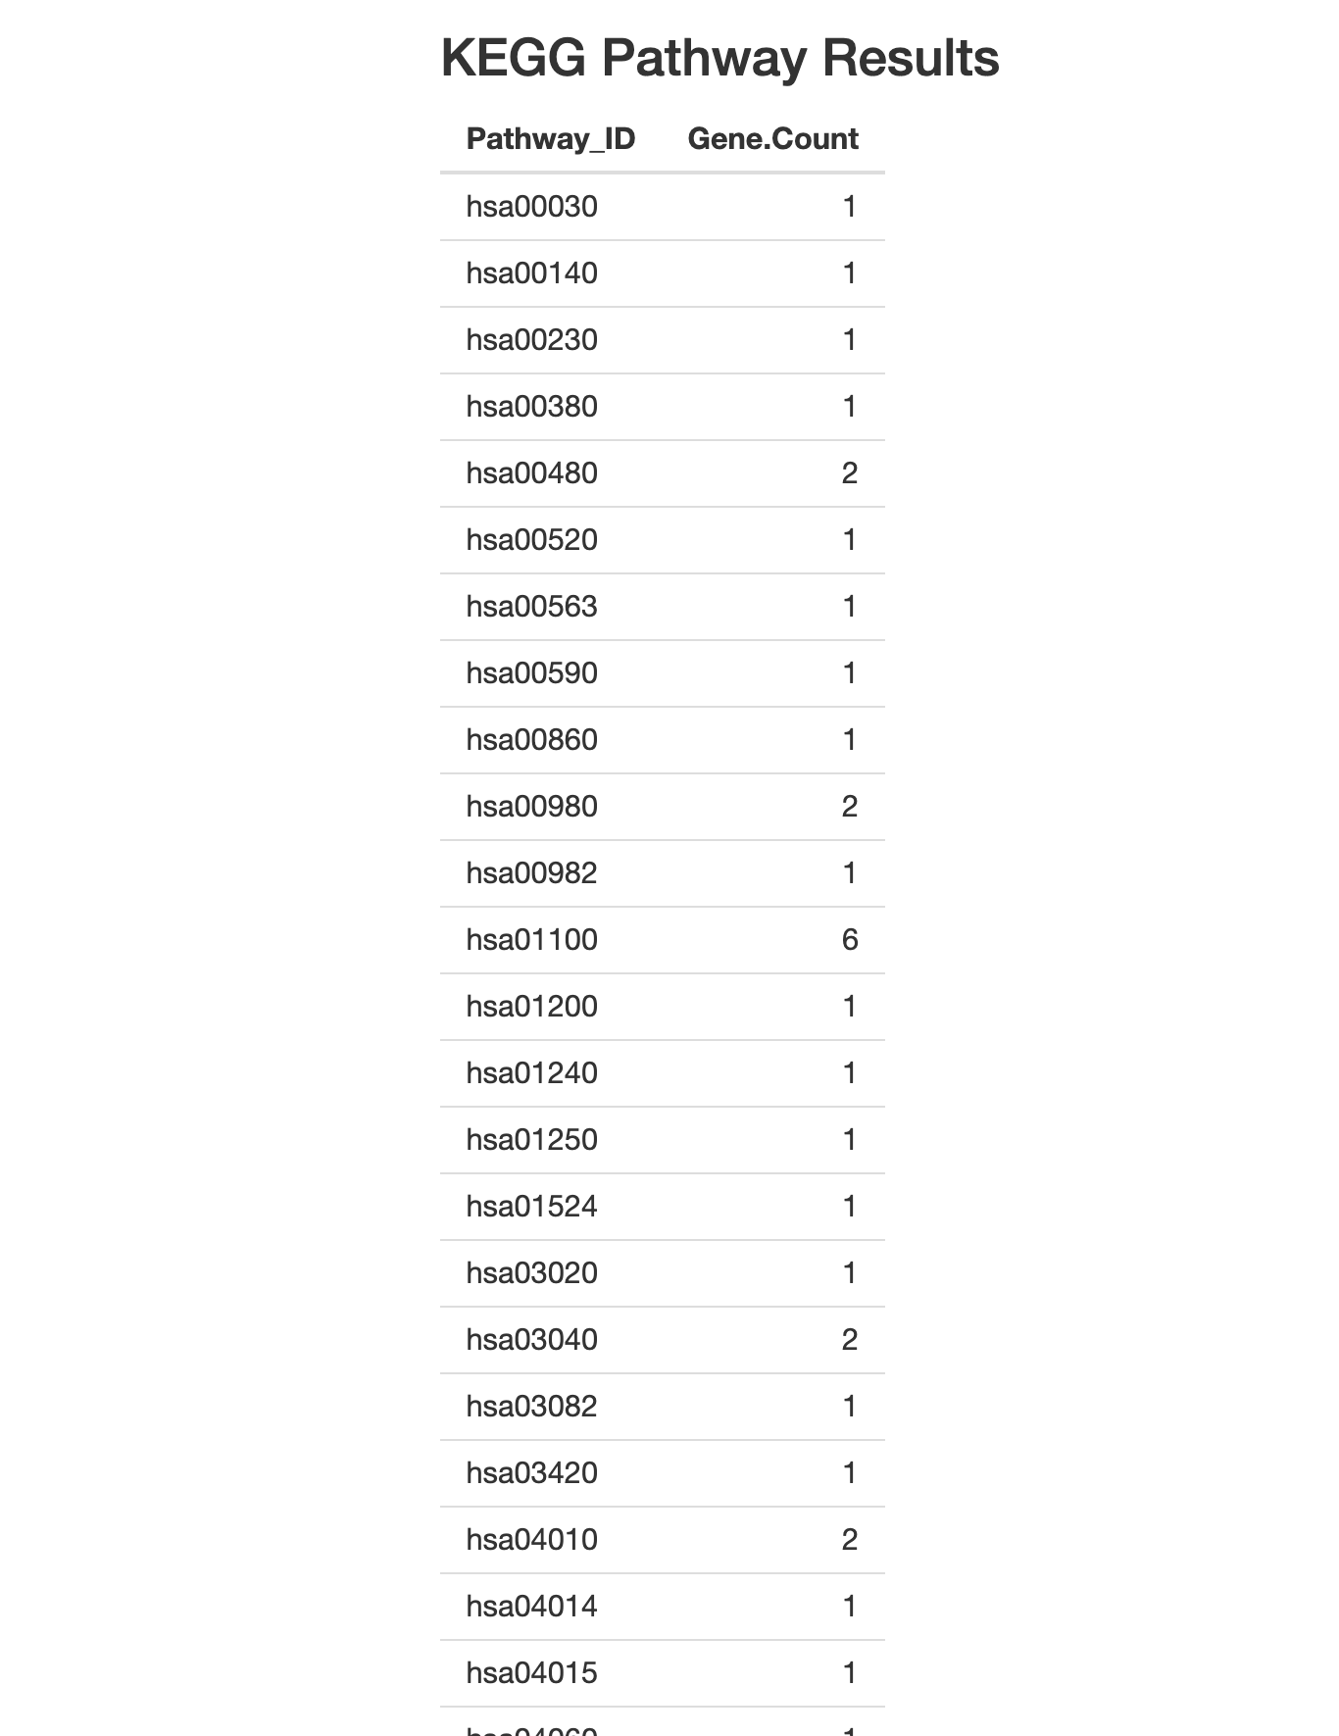
KEGG Pathway output – Table

Slide 20
Problems (what went wrong / in progress)
Inappropriate gene selections
In order to do these sorts of analyses properly (what is essentially KEGG/GO/FGSEA ranked order path analysis), particularly in very large datasets, it is important to look at both p-value and log2 fold change.
Genes which have very low p-value and a log2 fold change with an absolute value close to 1 are analyzed. I instead used distance from 0 as the metric for measuring expression so that there was a placeholder that would at least work with some data. However, using simple expression isn’t so valuable because some genes are always more highly expressed, though they’re not relevant to the question being asked, necessarily. Thus, this tool is not presently appropriate for research; it is not a valid way to analyze.

Slide 21
Problems (continued)
Synthetic data set
Additionally, the data cannot be well interpreted beyond just to demonstrate the app utility. I initially began working on the shiny app with the intention of doing a heatmap and some additionally analyses related ~250 full histone acetylomes as a dataset, the permission to use the data did not come quickly enough. As a result, I elected to find a differential expression study and work from there. However, that study was used on a mouse model (McCarthy et al., 2024) in concert with google generative AI prompt to output 100 random Ensembl Gene ID’s. I thought it would still be more desirable to build an app around the homo sapiens dataset on KEGG.
A silver lining, at least, is that you actually can use this app for the initial clustered heatmap of most differentially expressed genes within a mouse model. The first clustered heatmap It should theoretically function no matter the dataset provided that the first column name is GeneName (would have to be artificially changed or the app adjusted, and the rows represent variables. Only Ensembl IDs would work for the KEGG portions, however.

Slide 22
Problems (continued)
Tech issues
Unfortunately, I ran into quite a few complications using Bioconductor package--so much so I had to completely uninstall and reinstall R related to package corruption. As a result, I had less time to resolve issues (especially related to generating volcano plots for gene selection).
The number of genes that would have to be analyzed to achieve accurate results may be beyond the scope of a shiny app—at least, as I’ve created it. When I tried to run larger datasets (e.g., the mouse model DE dataset I looked at caused the app to crash unless culled).
In future, I think it would help to have some sort of local component for data filtering. In an ideal world, it would be great to include some button options in the app to filter on the basis of molecular function or tissue expression.
EX: retain only genes which are expressed in brain tissue.

Slide 23
What can be learned?
Given the problems, this is not a very useful app at present
It is a very useful way to get ahold of pathways rapidly, but unfortunately will not prioritize the correct genes
The tool can still be used to group information easily, but formatting quirks are likely to cause problems with interpretation of such datasets.
Needs filters (e.g., for genes by tissue expression)

Slide 24
Promising aspects
With some tweaking to select genes on p-value and log2 fold change, it will make KEGG extremely easy
Likely to substantially expedites workload and creating visualizations
Initial visualizations via heatmap are highly useful for viewing relatedness of genes and for demonstrating how they cluster together across participants
Fairly user friendly
“Table” output makes for easy transfer to establish new columns in an excel dataset

Slide 25
“Just for fun” ------ hypothetical discussion of results from synthetic data set
For this discussion, we will pretend that the substantial limitations of this app are not present (e.g., related to use of synthetic data and DE values rather than p-value and log2 fold change).
I ran the app using 50 genes, 6 clusters, and generated KEGG pathways as a barplot.
If we examine data from the initial heatmap from the synthetic data with a random set of Ensembl ID and DE values, we actually see that some genes seem more highly or less highly expressed across sets of participants. Interestingly, the pattern among those genes selected was almost never universal across participants, typically appearing to be grouped roughly into 2-3 sets of participants.
This would help guide towards other data—what do these particular participants have in common?

Slide 26
Hypotheticals (continued)
My guess is none of these genes are highly useful differentiating heteronormative and FXS from one another because they don’t seem too consistent.
Participant IDs in this synthetic data set corresponded to “wild type” (WT) and “FXS” (fragile x syndrome) and were marked for male/female. I initially created the synthetic data from a mouse study. One thing which could, hypothetically, be interesting is that participant gene expression didn’t seem to cluster perfectly on the basis of male/female, but there were some trends. Often, male versus female differed almost diametrically, and often to the same extent as in comparison to wild type vs fragile x.
KEGG analysis revealed 15 pathways, but really only one of these as highly expressed within the dataset, hsa01100, which is associated with metabolic pathways. The value generated was 6 (i.e., 6x expressed in the selected genes), so examining some of those genes for their role in metabolic pathways might offer some further insight into the nature of these similarities.

Slide 27
Works Cited
Constantino, J. N. (2018). Deconstructing autism: From unitary syndrome to contributory developmental endophenotypes. International Review of Psychiatry, 30(1), 18–24. https://doi.org/10.1080/09540261.2018.1433133
Tozzi, L., Zhang, X., Pines, A., Olmsted, A. M., Zhai, E. S., Anene, E. T., Chesnut, M., Holt-Gosselin, B., Chang, S., Stetz, P. C., Ramirez, C. A., Hack, L. M., Korgaonkar, M. S., Wintermark, M., Gotlib, I. H., Ma, J., & Williams, L. M. (2024). Personalized brain circuit scores identify clinically distinct biotypes in depression and anxiety. Nature Medicine, 30(7), 2076–2087. https://doi.org/10.1038/s41591-024-03057-9
McCarthy DM, Vied C, Trupiano MX, Canekeratne AJ et al. Behavioral, neurotransmitter and transcriptomic analyses in male and female Fmr1 KO mice. Front Behav Neurosci 2024;18:1458502. PMID: 39308631

Slide 28
GitHub Link:
https://github.com/JimRasband/DATA824_Final_Project_Spring_2025

